Slide 1
PALS
Parents!
Welcome...

Slide 2
Hello!
Thank you for joining us this evening to discuss the PALS assessment!
Dawn Gill, Reading Specialist
gilldd@pwcs.edu
Margaret MacGregor, Principal
macgremb@pwcs.edu

Slide 3
What is PALS?
The Phonological Awareness Literacy Screening (PALS) was developed by the University of Virginia. This assessment has been used in the state of virginia to assess early literacy since 1997.
Literacy means that someone can read and write. The PALS assessment measures each student’s ability to:
  decode –blend sounds together to read words
  encode – spell words
  understand and use language
As children’s skills improve in these three areas, they develop fluency and comprehension.

Slide 4
Let’s take a look at the
PALS Report!

Slide 5
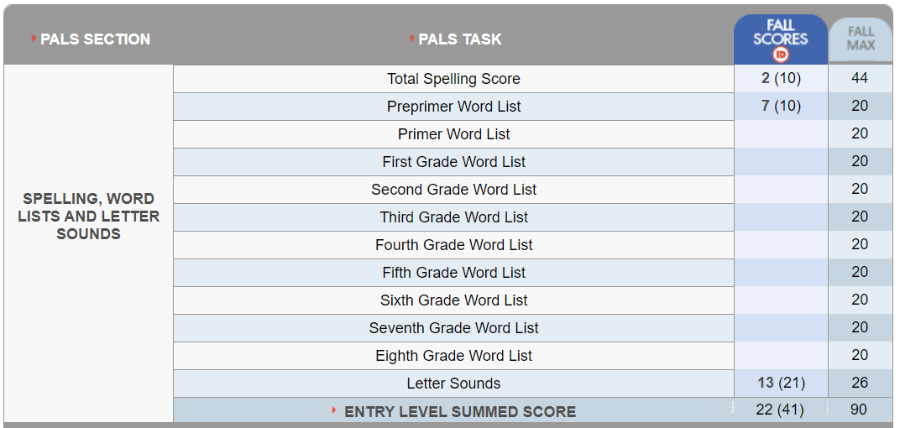
The PALS Report
Showcase places
100% Editable

Slide 6
The PALS Report
Showcase places
Spelling Score and benchmark
100% Editable

Slide 7
The PALS Report
Showcase places
Spelling Points Possible
100% Editable

Slide 8
The PALS Report
Showcase places
Preprimer Words
(Kindergarten)
100% Editable

Slide 9
The PALS Report
Showcase places
All word lists have 20 words.
100% Editable

Slide 10
The PALS Report
Showcase places
100% Editable
Letter Sound Score and benchmark

Slide 11
The PALS Report
Showcase places
100% Editable
Letter Sounds Possible

Slide 12
The PALS Report
Showcase places
100% Editable
Summed Score
(41 points needed to pass).

Slide 13
The PALS Report
Showcase places
100% Editable
Spelling Score +
Word List Score +
Letter Sounds =
Summed Score

Slide 14
If students do not meet the benchmark (41 points), additional tasks are required

Slide 15
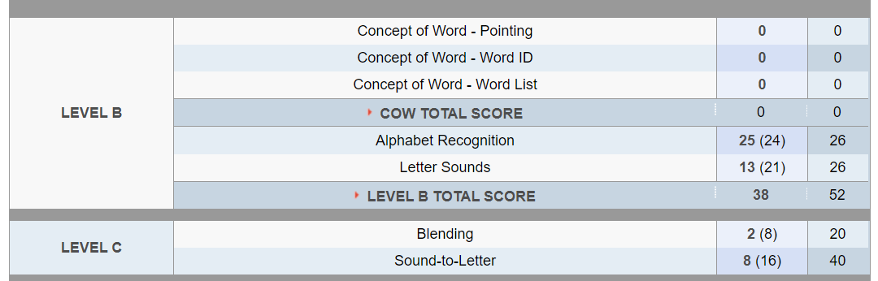
Additional Tasks - Levels B and C
These tasks are no longer assessed. The report has not been changed yet.

Slide 16
Additional Tasks - Levels B and C

Slide 17
Additional Tasks - Levels B and C

Slide 18
Additional Tasks - Levels B and C
Blending = putting sounds together to make a word.
For example: s – i – t = sit

Slide 19
Additional Tasks - Levels B and C
Sound-to-Letter = naming the sound in the beginning, middle, or end of a word.
For example: “What letter or sound do you hear at the end of “dog” – g or /g/

Slide 20
Instructional
Oral Reading Level

Slide 21
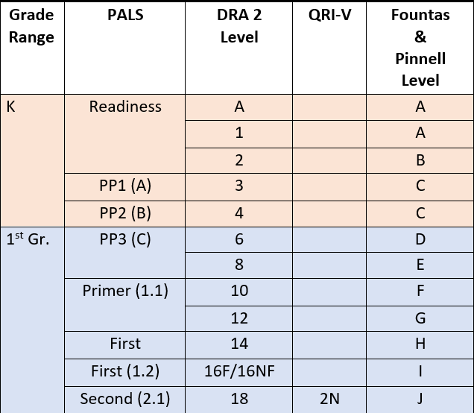
Instructional Reading Level
First Grade Students
Beginning of the Year
Pre-primer (PP2) = DRA Level 4
Accuracy = 85%
End of the Year
DRA Level 16-18
Accuracy = 90-95%

Slide 22
Did you know?
Without a strong foundation in reading, children are left behind at the beginning of their education.
More than 85 percent of the curriculum is taught by reading.
One of the most important predictors of graduating from high school is reading proficiently by the end of third grade.
By the end of third grade, 74% of struggling readers won’t ever catch up.
The Children’s Reading Foundation (www.readingfoundation.org)

Slide 23

Our Intervention Plan:

Slide 24
PALS Support
Identified students will receive 30 minutes of additional reading and phonics support each day (2.5 hours/week). This support is provided by our two PALS tutors.
Students will receive phonics instruction daily as part of the Language Arts block. Leesylvania is using the Phonics Units of Study.
Students receive additional, targeted support during RTI.

Slide 25

How Can You Help?

Slide 26


Read with your child!
Set aside time each day for family reading
Read WITH your child or TO your child
Talk about what you are reading. Share what you like about the book, the characters, or the storyline.

Slide 27

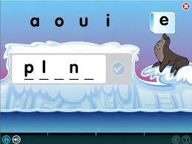

Use Lexia!
Lexia is a research-based program that supports phonics and reading.
Lexia is adaptive, and tracks student progress
All students have access to Lexia through their Office 365 account.

Slide 28




Additional Resources
PALS Website
Reading Rockets
Colorin Colorado!
For a list of reading resources, visit https://pals.virginia.edu/public/resources-home.html
https://www.readingrockets.org/
A bilingual site for educators and families of English Language Learners.
https://www.colorincolorado.org/
https://www.rif.org/literacy-central/parents

Slide 29
Thank you!
Questions? Comments?
Please contact Dawn Gill
gilldd@pwcs.edu
703.670.8268

