Slide 1
PALS
Parents!
Welcome...

Slide 2
Hello!
Thank you for joining us this evening to discuss the PALS assessment!
Dawn Gill, Reading Specialist
gilldd@pwcs.edu
Margaret MacGregor, Principal
macgremb@pwcs.edu

Slide 3
What is PALS?
The Phonological Awareness Literacy Screening (PALS) was developed by the University of Virginia. This assessment has been used in the state of virginia to assess early literacy since 1997.
Literacy means that someone can read and write. The PALS assessment measures each student’s ability to:
  decode –blend sounds together to read words
  encode – spell words
  understand and use language
As children’s skills improve in these three areas, they develop fluency and comprehension.

Slide 4
Let’s take a look at the
PALS Report!

Slide 5
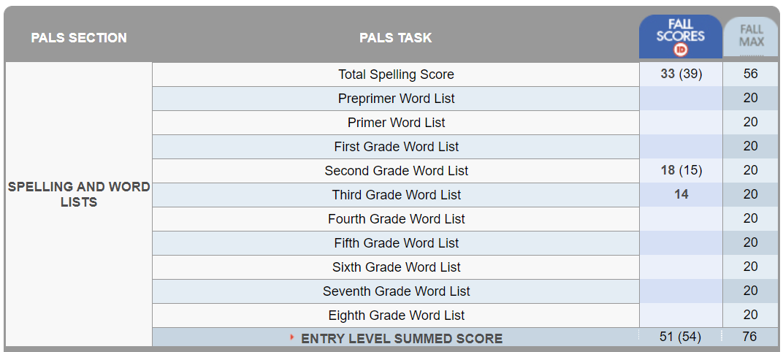
The PALS Report

Slide 6
The PALS Report
Spelling Score and benchmark

Slide 7
The PALS Report
Showcase places
Spelling Points Possible
100% Editable

Slide 8
The PALS Report
Showcase places
Second Grade Words
100% Editable

Slide 9
The PALS Report
Showcase places
All word lists have 20 words.
100% Editable

Slide 10
The PALS Report
Showcase places
100% Editable
Summed Score
(54 points needed to pass).

Slide 11
The PALS Report
Showcase places
100% Editable
Spelling Score +
Word List Score =
Summed Score

Slide 12
If students do not score at least 15 on pre-premier word list, additional tasks are required

Slide 13
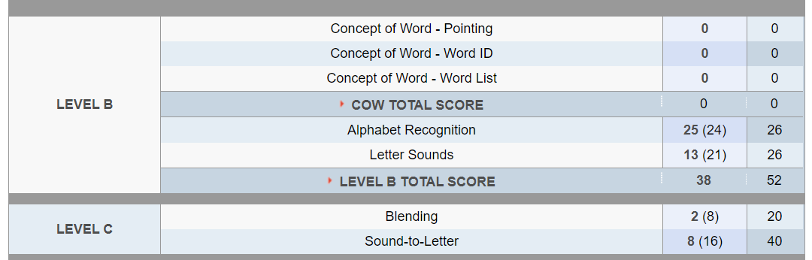
Additional Tasks - Level B
These tasks are no longer assessed. The report has not been changed yet.

Slide 14
Additional Tasks - Level B

Slide 15
Additional Tasks - Level B

Slide 16
Instructional
Oral Reading Level

Slide 17
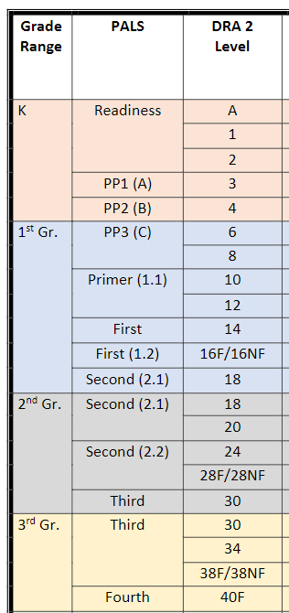
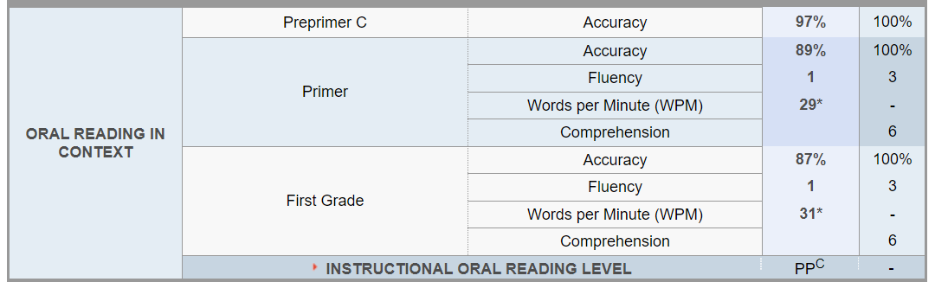
Instructional Reading Level
Second Grade Students
Beginning of the Year
End of Second Grade = DRA Level 28/30
Accuracy = 90-95%
End of the Year
End of Third Grade = DRA Level 38/40
Accuracy = 90-95%

Slide 18
Did you know?
Without a strong foundation in reading, children are left behind at the beginning of their education.
More than 85 percent of the curriculum is taught by reading.
One of the most important predictors of graduating from high school is reading proficiently by the end of third grade.
By the end of third grade, 74% of struggling readers won’t ever catch up.
The Children’s Reading Foundation (www.readingfoundation.org)

Slide 19

Our Intervention Plan:

Slide 20
PALS Support
Identified students will receive 30 minutes of additional reading and phonics support each day (2.5 hours/week). This support is provided by our two PALS tutors.
Students will receive phonics instruction daily as part of the Language Arts block. Leesylvania is using the Phonics Units of Study.
Students receive additional, targeted support during RTI.

Slide 21

How Can You Help?

Slide 22


Read with your child!
Set aside time each day for family reading
Read WITH your child or TO your child
Talk about what you are reading. Share what you like about the book, the characters, or the storyline.

Slide 23

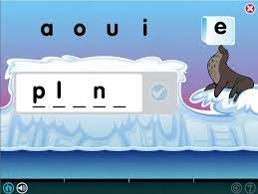

Use Lexia!
Lexia is a research-based program that supports phonics and reading.
Lexia is adaptive, and tracks student progress
All students have access to Lexia through their Office 365 account.

Slide 24




Additional Resources
PALS Website
Reading Rockets
Colorin Colorado!
For a list of reading resources, visit https://pals.virginia.edu/public/resources-home.html
https://www.readingrockets.org/
A bilingual site for educators and families of English Language Learners.
https://www.colorincolorado.org/
https://www.rif.org/literacy-central/parents

Slide 25
Thank you!
Questions? Comments?
Please contact Dawn Gill
gilldd@pwcs.edu
703.670.8268

